Slide 1

Performance Engineer Prepared Scenario
Louis George Henrydass

Slide 2
APPROACH
Random Pages were selected from sorted.com web
Performance Test scripts were created to inject load on the chosen pages
Metrics from performance test tools were provisioned to enable LIVE monitoring
Test process automated to aid CI/CD
TOOLS USED
Jmeter v5.5 – Testing Tool
Prometheus – TSDB to collect KPIs
Grafana – LIVE Application Monitoring
Git – Source code
Jenkins – Continuous Integration

Slide 3
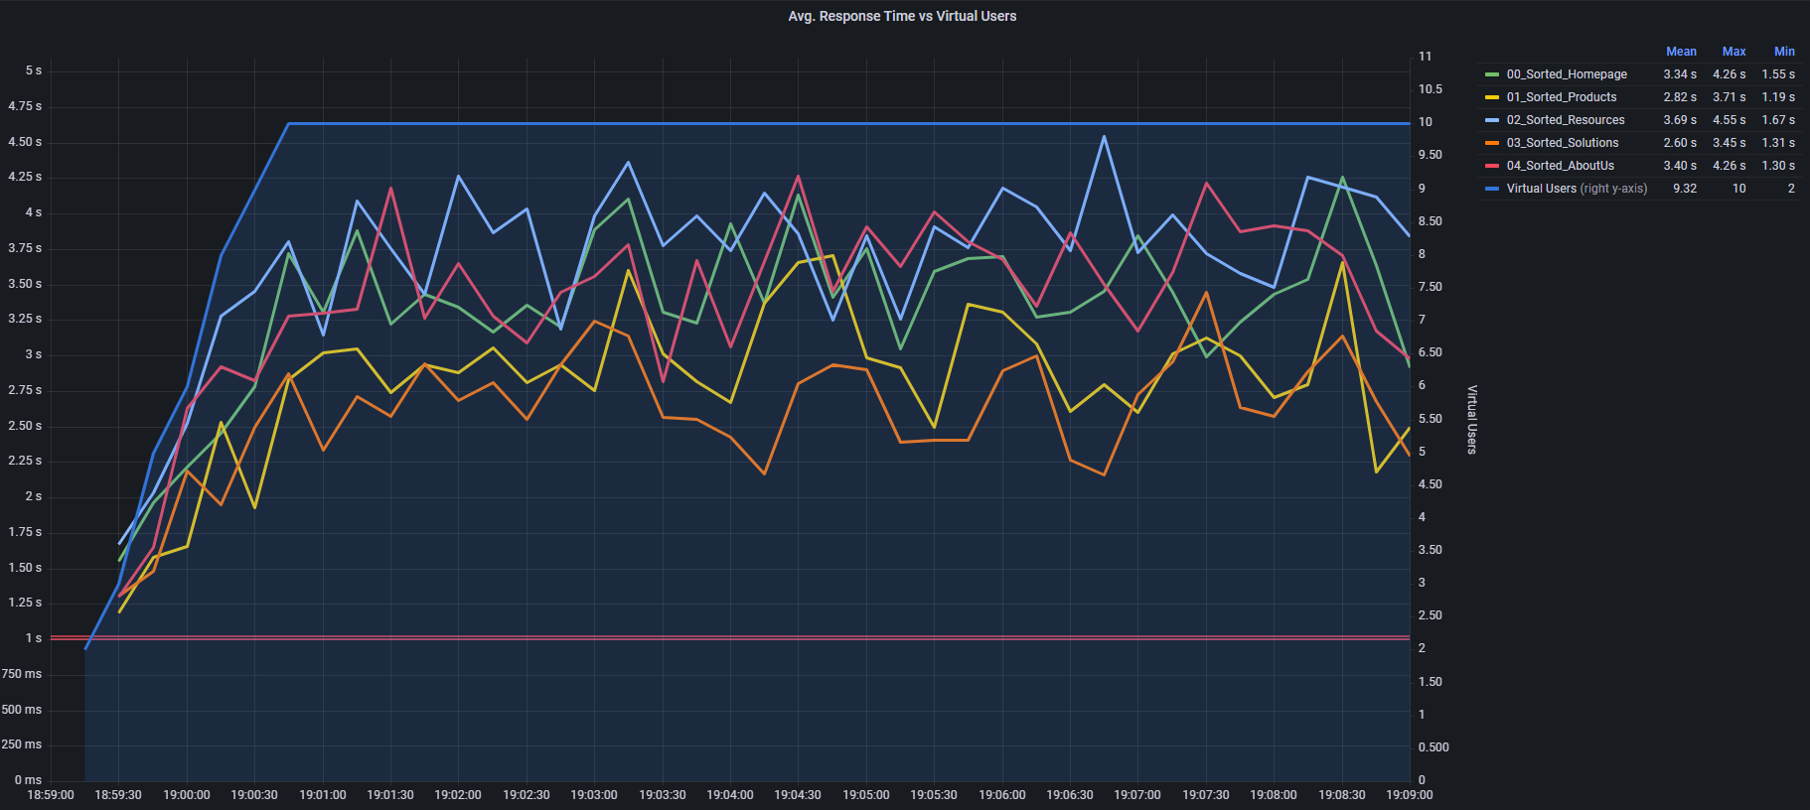
LOAD TEST RESULTS – 10 USERS
Threshold Line
( SLA of 1 Second)

Slide 4
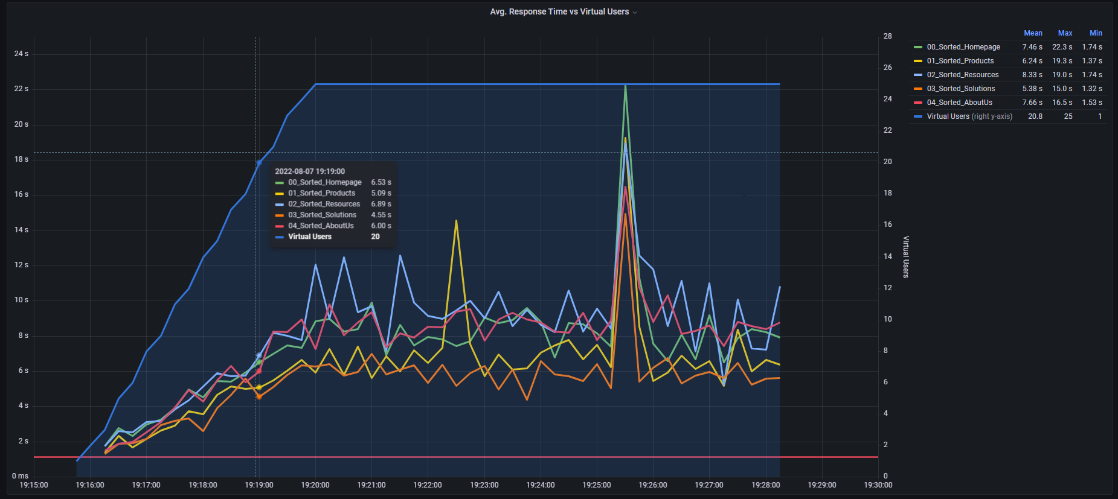
LOAD TEST RESULTS – 25 USERS
Threshold Line
( SLA of 1 Second)

Slide 5
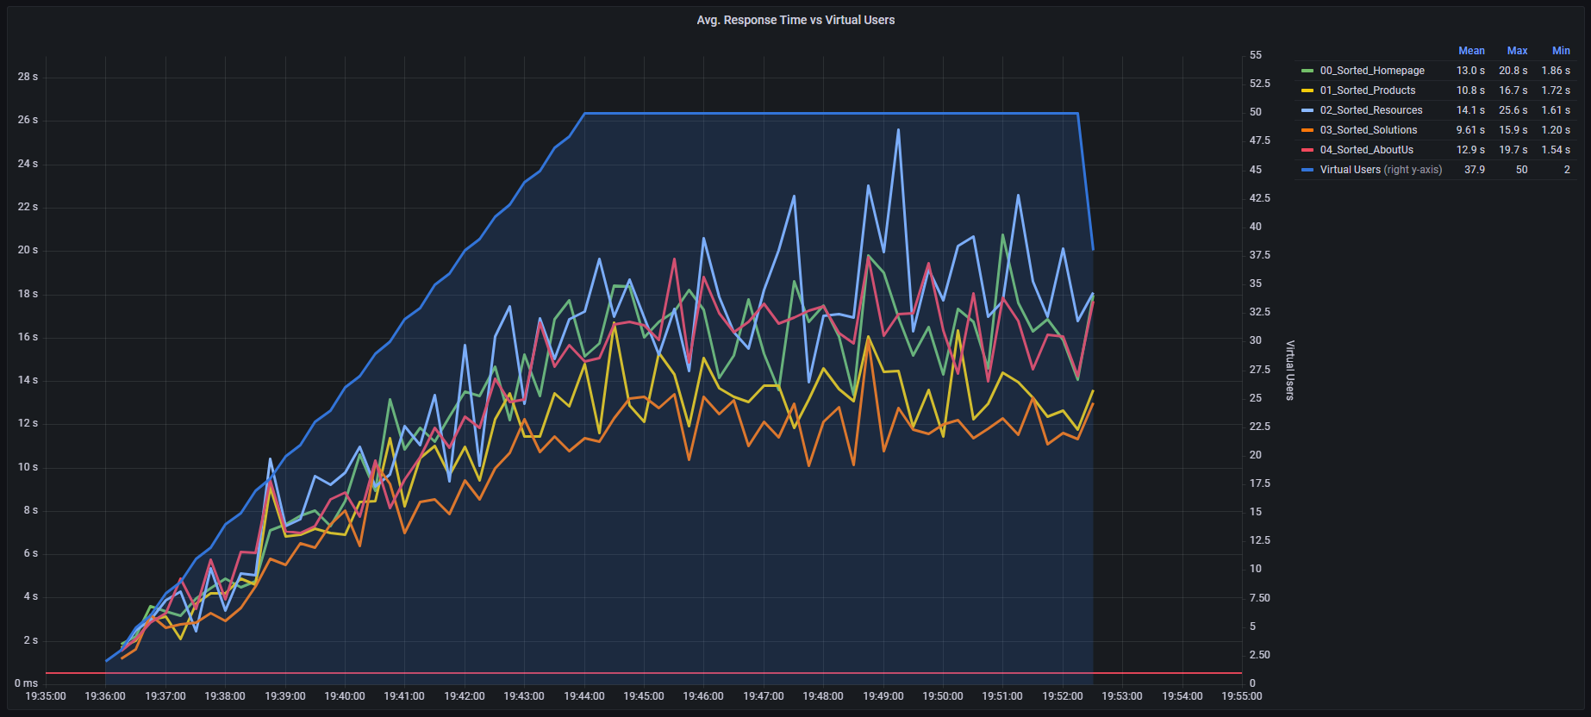
LOAD TEST RESULTS – 50 USERS
Threshold Line
( SLA of 0.5 Second)

Slide 6
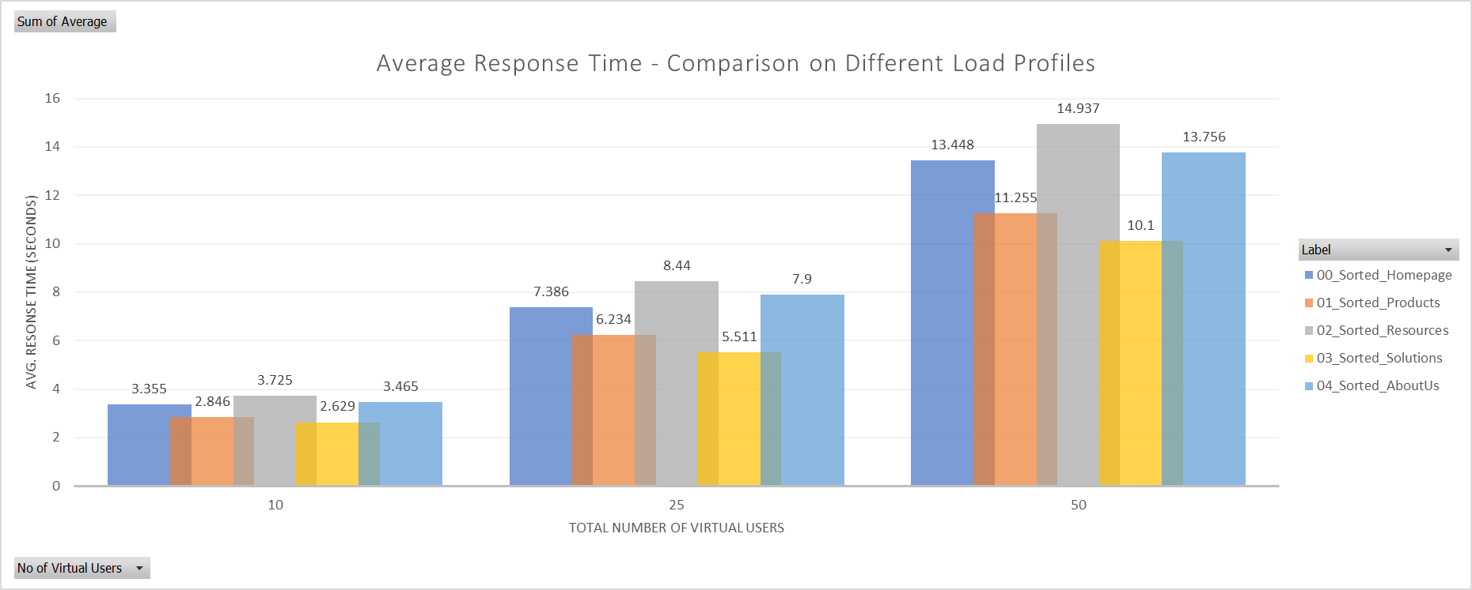
COMPARISON BETWEEN LOAD PROFILES

Slide 7
CONCLUSION
Sorted.com web application didn’t meet the SLA defined for the various load profiles.
Further breakdown on the E2E response times should be identified to know the hotspots/bpttleneck
E2E response time provided includes retrieval of embedded resources within the application.
REPOSITORY
https://github.com/louiscodehub/Sorted

